Slide 1


CSA-0504 – Database management systems
CO 1- AT 3 - Technical Presentation
Presented by:
Sohail(192511120)
BE.CSE

Slide 2
1. Online library system
What is an Online Library System?
An Online Library System is a database application used to manage books, members, borrowing, and returning activities efficiently.
Objectives
Store book details
Manage library members
Track book borrowing and returns
Maintain librarian information
Reduce manual record keeping

Slide 3
Main entities
1. Book
Book_ID (Primary Key)
Title
Author
ISBN
Category
Member
Member_ID (Primary Key)
Name
Email
Phone
3. Librarian
Librarian_ID (Primary Key)
Name
Contact
4. Borrow
Borrow_ID (Primary Key)
Issue_Date
Return_Date
Fine
Relationships
Member borrows Book
Librarian manages Borrow records
Borrow links Member and Book

Slide 4
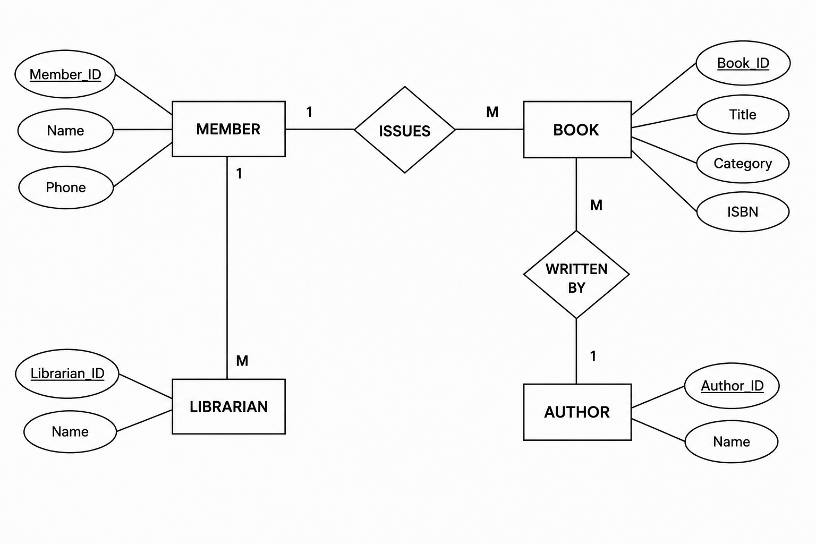

Slide 5
2. Generalization and Specialization with a University Case Study
The EER Model is an advanced version of the ER model that represents more complex data relationships using concepts such as inheritance and subclasses.
Features
Supports inheritance
Represents superclass and subclass relationships
Reduces data redundancy
Models real-world scenarios more accurately
Key Concepts
Generalization
Specialization
Inheritance
Superclass and Subclass

Slide 6
Generalization and Specialization
Generalization
Combines multiple similar entities into one common
Bottom-up approach.
Common attributes are moved to the superclass.
Example:
Student
Faculty
Staff
⬇
Person (Superclass)
Specialization
Divides one superclass into multiple subclasses based on specific characteristics.
Top-down approach.
Subclasses inherit attributes from the superclass.
Example:
Person
⬇
Student
Staff

Slide 7
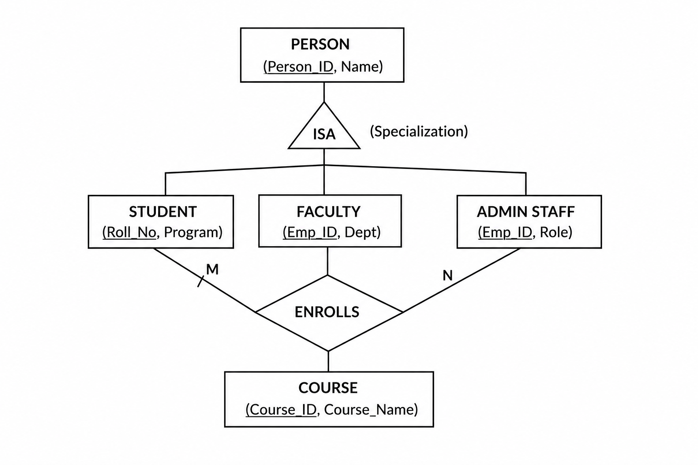

Slide 8
3. Data Independence in DBMS
Data Independence is the ability to modify the database schema at one level without affecting the schema at the next higher level.
Three Levels of DBMS Architecture
External Level – User Views
Conceptual Level – Logical Database Structure
Internal Level – Physical Storage Structure
Benefits
Easier database maintenance
Improved flexibility
Better scalability

Slide 9
Physical Data Independence
Ability to change the physical storage without affecting the logical schema.
Changes occur at the internal level.
Examples
Changing file organization
Adding indexes
Compressing data
Upgrading storage devices
Logical Data Independence
Ability to change the logical schema without affecting user.
Changes occur at the conceptual level.
Examples
Adding new attributes
Creating new tables
Modifying relationships
Splitting or merging tables

Slide 10
Comparision
Feature | Logical Data Independence | Physical Data Independence
Level | Conceptual Level | Internal Level
Changes | Tables, attributes, relationships | Storage, files, indexes
Affects | User views should remain unchanged | Logical schema remains unchanged
Difficulty | More difficult | Easier
Example | Add a new column to Student table | Create an index on Student_ID

Slide 11
4. Software Components of a Database Management System
A Database Management System (DBMS) consists of several software components that work together to store, retrieve, and manage data efficiently.
Major Components
Query Processor
Storage Manager
Transaction Manager
Objectives
Process user queries
Manage data storage
Ensure data consistency and security
Support multiple users simultaneously

Slide 12
Query processor
The Query Processor interprets and executes SQL queries submitted by users.
Functions
Parses SQL queries
Validates query syntax
Optimizes query execution
Generates an execution plan
Retrieves requested data efficiently
Example
SQL Query:
SELECT * FROM Student WHERE Department = 'CSE';

Slide 13
Storage manager
The Storage Manager is responsible for storing, retrieving, and updating data in the database.
Functions
Manages database files
Organizes records and indexes
Controls disk space allocation
Ensures efficient data access
Transaction manager
The Transaction Manager ensures that database transactions are executed safely and reliably while maintaining data consistency.
Functions
Manages transactions
Controls concurrent access
Performs commit and rollback operations
Ensures ACID properties:

Slide 14
5. Strong and Weak Entities in ER Modeling
An entity is a real-world object or concept that stores information in a database.
Strong Entity
Has its own Primary Key.
Exists independently.
Represented by a single rectangle in an ER diagram.
Example: Employee (Employee_ID, Name, Department)
Weak Entity
Does not have a complete Primary Key.
Depends on a Strong Entity.
Represented by a double rectangle in an ER diagram.
Example: Dependent (Dependent_Name, Age)

Slide 15
Comparison with Real-World Example
Employee and Dependent
Employee is a Strong Entity because it has a unique Employee_ID.
Dependent is a Weak Entity because it cannot exist without an Employee.
Feature | Strong Entity | Weak Entity
Primary Key | Has its own Primary Key | Has a Partial Key
Dependency | Independent | Depends on Strong Entity
ER Symbol | Single Rectangle | Double Rectangle
Example | Employee, Student | Dependent, Order Item

Slide 16


